Slide 1
Notes:
Introduce yourself.
The American Association of University Women (AAUW) is a nationwide network of more than 100,000 members and donors, 1,000 branches, and 600 college/university institution partners.
For 130 years, AAUW members have examined and taken positions on the fundamental issues of the day — educational, social, economic, and political. Our commitment to our mission is reflected in all aspects of our work.

Slide 2
THE SIMPLE TRUTH ABOUT THE GENDER PAY GAP
Presented by
Nina Thayer, June 8, 2012
Notes:
Pay equity for women has long been a priority for the American Association of University Women. Since 1913, AAUW has worked to push legislation and policies that encourage and enforce fair pay in the workplace.
This presentation is meant to provide the basic facts about the gender pay gap. It is a summary of the AAUW publication, The Simple Truth about the Gender Pay Gap, which is updated regularly with new and updated statistics. We hope that you will leave this presentation feeling educated and empowered.

Slide 3
What Is the Pay Gap?
The pay gap is a comparison between men’s and women’s typical earnings, using either weekly or annual median earnings.
The median value is the middle value, with equal numbers of full-time workers earning more and earning less.
It is used to prevent especially high salaries from skewing the results.
Notes:
The pay gap is one of the leading issues for women today. This presentation provides an overview of this important issue, which we hope will help you explain it to others.
The gender pay gay is a comparison of men’s and women’s median earnings.
Median earnings are typical, not average, earnings. Looking at the salaries of all men and/or women working full-time, the median is the number in the middle of the group. We often say “typical” to refer to median because it is the person “right in the middle.” Half of the people earn more and half earn less.
[Why not use averages? Because very high earnings can pull up the average, but they don’t pull up the middle point in the same way. Average wages tend to be higher than median wages.]
Earnings are usually measured on a weekly or annual basis. Both are valid ways of comparing earnings.

Slide 4
What Is the Pay Gap?
The earnings ratio and the pay gap for 2010 are calculated using these formulas:
Earnings Ratio =
women’s median earnings
= 77%
men’s median earnings
men’s median earnings – women’s median earnings
= 23%
Pay Gap =
men’s median earnings
Notes:
The calculation of the earnings ratio and the pay gap is simple [read chart].
The earnings ratio for 2010 was 77%, and the pay gap was 23%.
The numbers displayed here represent the pay gap on a national level. However, using this same formula and current data from the U.S. Census Bureau, you can calculate the pay gap for your individual state. The state pay gap can be found on page 7 of The Simple Truth About the Gender Pay Gap 2012.

Slide 5
The Pay Gap Geographically
Earnings Ratio for Rocky Mountain States in 2010
Nevada 83%
Arizona 82%
Colorado 79%
New Mexico 79%
Montana 73%
Utah 69%
Wyoming 64%

Slide 6
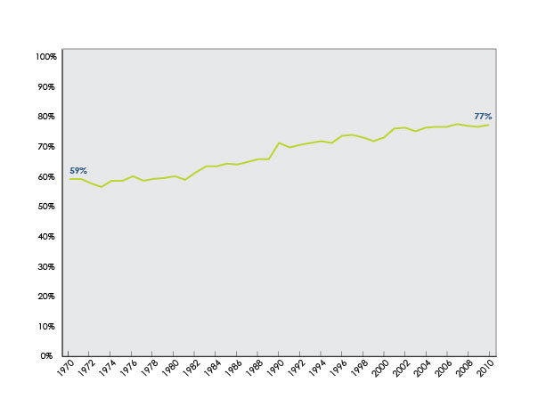
The Pay Gap over Time
Women’s Earnings as a Percentage of Men’s Earnings for Full-Time, Year-round Workers, 1970–2010
Notes:
While the pay gap has steadily narrowed over time, it is nowhere near being eliminated entirely, and in recent years progress has actually stalled. In the past decade (2000 to 2010), the pay gap rose from 73 percent to 77 percent, for an annual growth rate of under one-half of one percent.
At this rate, it will be more than 60 years before the gap closes completely.

Slide 7
What about Choices?
Men and women tend to choose different majors in college and to work in different occupations after college.
Women tend to work fewer hours, even when they work full-time.
Women are more likely to leave the workforce or to work part-time when they have young children.
Choices can account for some of the differences in salaries, but they aren’t the whole story.
Notes:
Both men and women makes choices that affect their salaries, and in turn, this affects the pay gap.
Men and women still tend to choose different majors in college and to work in different occupations after college.
Women also tend to work fewer hours, even when they work full-time (full-time work is defined by the Bureau of Labor Statistics as 35 hours a week or more).
Women are more likely to leave the workforce or work part-time when they have young children.
Choices account for some of the differences in salaries, but they aren’t the whole story.
The AAUW report Behind the Pay Gap examines this question. After accounting for the issues raised above as well as others, our study found that there was a five percent difference in the earnings of men and women one year after college graduation that was still unexplained.

Slide 8
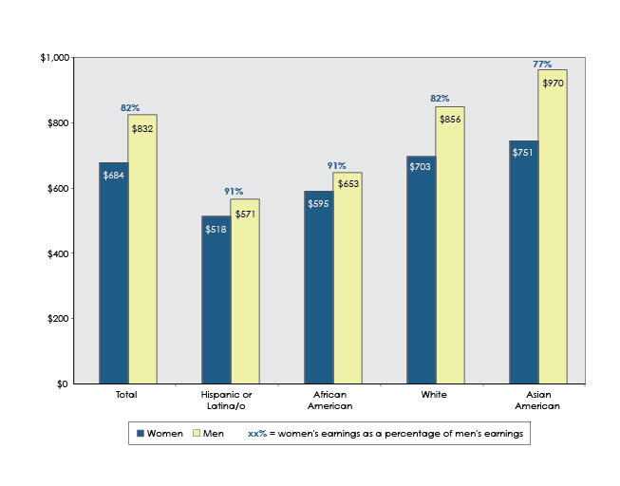
The Pay Gap and Race/Ethnicity
Weekly Median Earnings of Full-time Wage and Salary Workers, Ages 16 and Older, by Race/Ethnicity and Gender, 2011
Notes:
The pay gap affects women from all backgrounds, but its effects vary between different demographics.
The chart shown here lays out the pay gap by race/ethnicity among full time workers in 2011.
You can see that Hispanics and African Americans, both men and women, had lower weekly median earnings than whites and Asian Americans.
Women typically earned less than men within each racial and ethnic group, and the pay gap between men and women was smaller among African Americans and Hispanics compared with whites and Asian Americans.
It is clear from the chart, however, that this smaller gender pay gap among African Americans and Hispanics is due solely to the fact that African American, Hispanic, and Latino men, on average, earned substantially less than white men in 2011.
Asian American and white women earned more than Hispanic and African American women, and Asian American men were the highest earners.

Slide 9
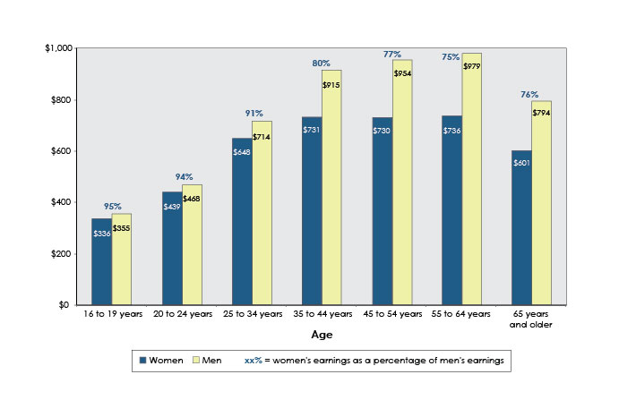
The Pay Gap and Age
Weekly Median Earnings of Full-time Workers, by Gender and Age, 2010
Notes:
The pay gap is narrow among younger women and men, increasing in size among middle-aged and older groups.
For example, in this chart, you can see that there is only a small gap of 5 to 6% among young people age 16 to 24.
At peak earning years, in contrast, we see a pay gap of 20 percent at ages 35 to 44, and even larger gaps of 23 percent among those ages 45 to 54 and 25% among those ages 55 to 64.
At no point do women workers earn as much as male workers in the same age category.

Slide 10
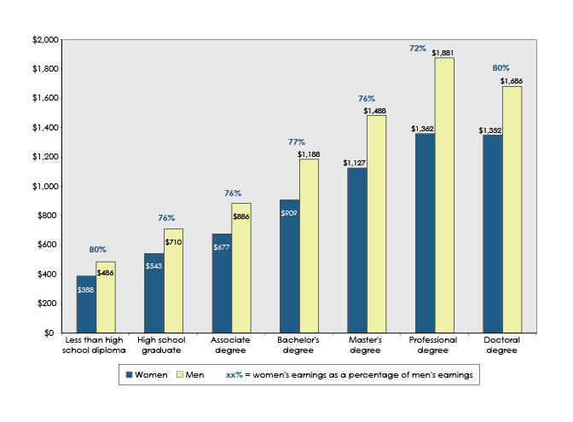
The Pay Gap and Education
Weekly Median Earnings of Full-time Workers, by Gender and Education Level, 2010
Notes:
While earnings tend to increase with education level, education does not eliminate the pay gap. The pay gap exists at all levels of education, and in some cases, is larger with higher levels of education.
For example, this chart shows that women with bachelor’s degrees earned 77 percent as much as their male peers earned in 2010, yet women with professional degrees only earned 72 percent of the earnings of men with professional degrees.

Slide 11
The Pay Gap in Academia
“Persistent Inequity: Gender and Academic Employment”
by
John W. Curtis, Director of Research and Public Policy,
American Association of University Professors
Prepared for a White House event,
“New Voices in Pay Equity”
on Equal Pay Day, April 11, 2011
12 Pages, 10 Graphs, and 40 References.
Notes:
This is some of the most recent academic research. I have one copy and will gladly make more copies. Let me read the first paragraph by Director Curtis:

Slide 12
Public Policy
Lilly Ledbetter Fair Pay Act, signed into law on January 29, 2009
Paycheck Fairness Act
52-47 Senate vote against cloture earlier this week
The Fair Pay Act
The “Wal-Mart fix” legislation
Regulations, executive orders, and enforcement efforts
Notes:
Wal-Mart v. Dukes, a 2011 Supreme Court decision, severely restricted the ability of workers to fight discrimination together in a class action. Champions in the House and Senate have vowed to legislatively “fix” the flawed court decision.
Regulations, executive orders, and enforcement efforts by the administration can be particularly helpful. For example, the Small Business Administration recently issued regulations raising the loan caps for women business owners seeking loans through the Women’s Procurement Program, leveling the field for women and men who own competing businesses seeking federal contracts.
The executive branch should also issue guidance on the permissibility of gender-based affirmative action and reinstating the Equal Opportunity Survey, which would require all federal contractors to submit data on their employment practices, such as hiring, promotions, terminations, and pay.
The Department of Labor’s Women’s Bureau, the only federal agency devoted to the concerns of women in the workplace, should be fully funded to continue its important work on fair pay issues.

Slide 13
Conclusion
The pay gap is real and pervasive, and it affects all women.
Individuals, employers, and communities need to take action.
Have you or someone you know experienced sex discrimination at work? Check page 21 of The Simple Truth about the Gender Pay Gap & visit us online at www.aauw.org for guidance.
Notes:
The pay gap is real and pervasive, and it affects all women.
There is no one silver bullet. Rather, individuals, employers, and communities need to take action.
For more information and resources, including our pamphlet The Simple Truth about the Gender Pay Gap, visit us online at www.aauw.org. The online version will always have up-to-date information on the pay gap.
Thank you for coming to our presentation. To get informed and involved on pay equity and other issues affecting women and girls, you can check out the American Association of University Women website at www.aauw.org.

Slide 14
Conclusion
Information is the basis for understanding.
Understanding is the basis for action.
Action is the basis for change.
The time has come for the Gender Pay Gap to disappear!

